Slide 1
Income Classification: ML
Implementing KNN, Logistic Regression, Random Forest, XGBoost & Neural Network on Binary Classification for Making 50k+ a Year or Not
Loyola University New Orleans
Carter Roberts

Slide 2
Goals & Preprocessing

Slide 3
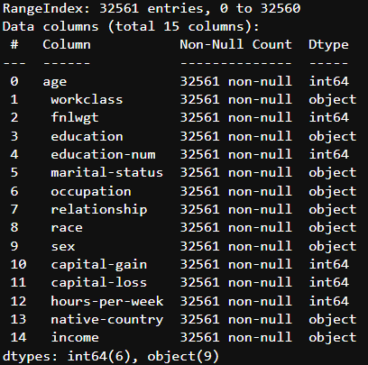
Explanation, Dataset Columns
TARGET: income – two values; >50k or <=50k; how much money made a year by row individual
Age, sex, race, capital-gain, capital-loss, occupation, marital-status, relationship, hours-per-week, native-country, education-num, education: exactly what it sounds like
workclass: options federal, private, etc.
fnlwgt – final weight, number of people with identical or near-identical stats

Slide 4
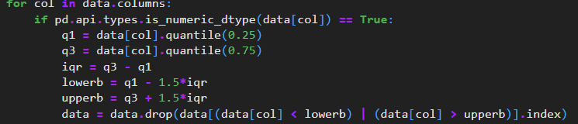



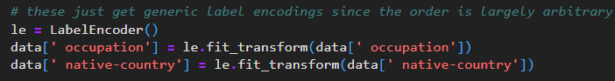
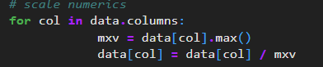
Things We Need to Do for Processing
Remove “?” as object column unique val.
Remove faulty object column unique vals.
Remove numerical outliers
Remove columns which have 1 unique value without their outliers (capital-[G/L])
One-hot encode object columns with less than or equal to 7 options
Label encode nominally-ordered object columns, or object columns with 8+ options
Scale numerical data
Change encoded bools to int64 for ease

Slide 5
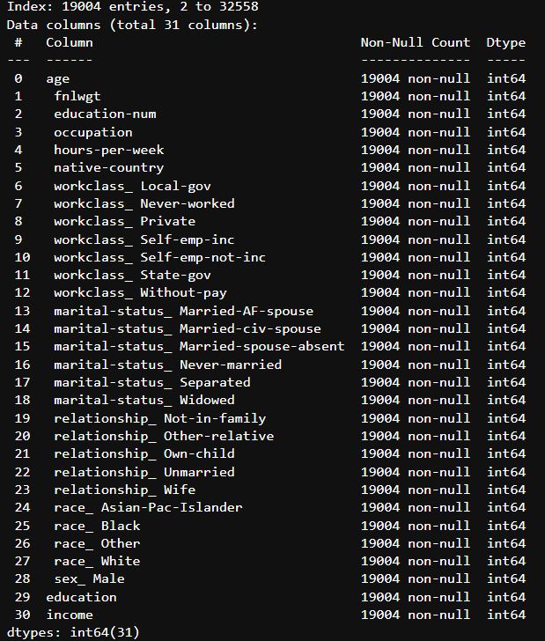
Finally Processed Data
Uniform data types, but encoded can function as bool since have only 0 and 1
IQR outlier removal drop almost half the original count – first- vs. third-world wealth disparity – decision kept because otherwise, accuracy is always lower
Capital gain / loss removed since all the people left after outlier removal have 0 capital gain / loss – wealth disparity again as well as national differences – decision kept because otherwise, accuracy lower

Slide 6
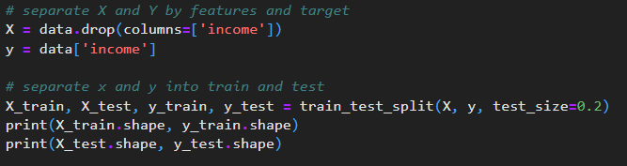
Training & Testing: All but NN

Slide 7
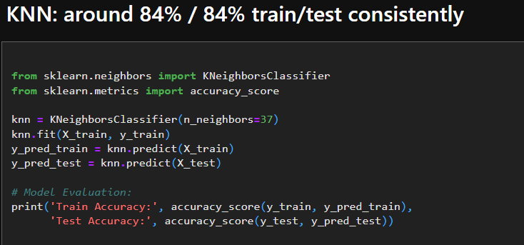
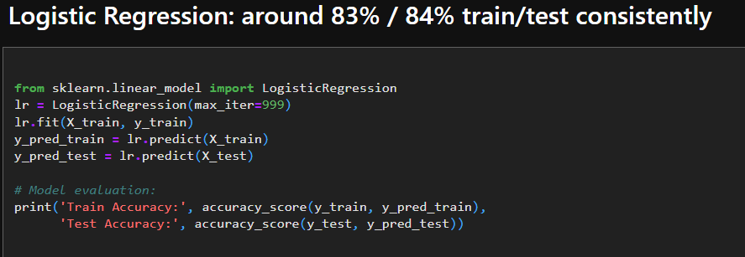
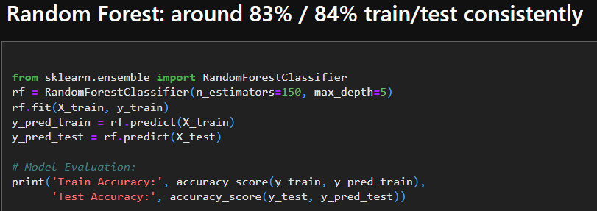
KNN, Logistic Regression, Random Forest
KNN uses 37 nearest neighbors, since 37 = [(sqrt of non-null rows) - 100]
Logistic Regression has a maximum of 999 iterations
Random Forest uses 150 estimators with a maximum depth of 5
TRAIN ACCURACY TEST ACCURACY
KNN
0.8425968558837071 0.8403051828466193
Logistic Regression
0.833322370584753 0.8410944488292554
Random Forest
0.8311517463658489 0.842409892133649

Slide 8
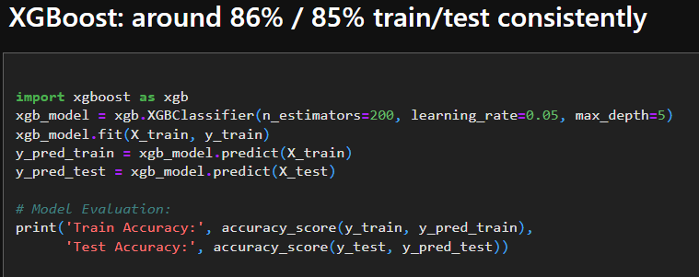
KNN, Logistic Regression, Random Forest
XGBoost uses 200 estimators at a max depth of 5 and a learning rate of 0.05.
TRAIN ACCURACY TEST ACCURACY
XGBoost
0.8620666973623627 0.8521441725861615

Slide 9
Setting up Neural Network

Slide 10
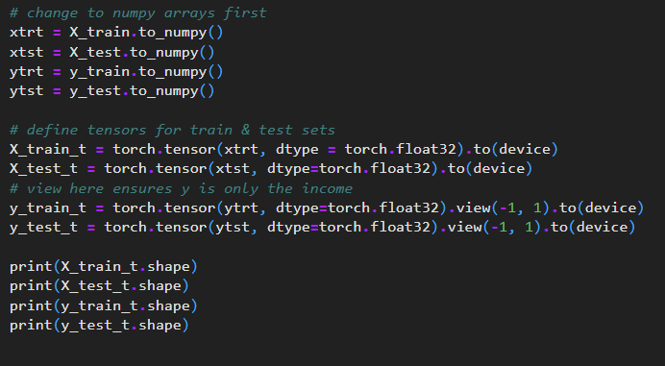
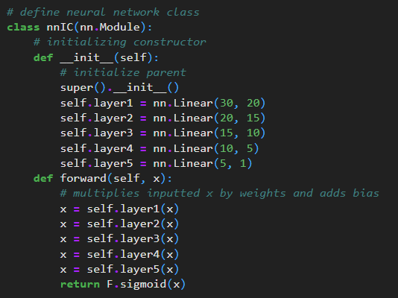
Tensor Conversion & Neural Network Class Definition
Torch can’t directly convert a DataFrame into a tensor, so first the train/test sets are turned to numpy arrays.
The y-sets need to be altered in the conversion so that their shape matches the target output being 1.
Shapes:
X_train_t = [15203, 30]
X_test_t = [3801, 30]
y_train_t = [15203, 1]
y_test_t = [3801, 1]
The nnIC class has 5 layers; it needs to accept the 30 features from X and reduce it down to 1 over time. Sigmoid function “straightens” data.

Slide 11
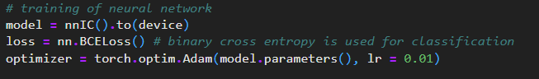
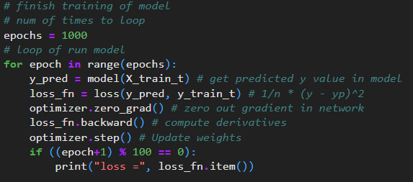
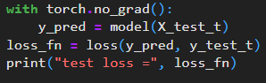
Training & Testing for Neural Network
An instance of the neural network class is created, as well as an instance of the binary-cross-entropy loss function and the Adam optimizer (learning rate of 0.01).
For 1000 loops, the network is used to predict y_train_t and a loss is generated. The optimizer zeroes out the gradient of the network, then the derivatives are computed with the loss function. Weights are updated with the optimizer, and the loop repeats. After 1000 loops, training loss is 0.3470097482204437.
Without a gradient, the network is used to predict y_test_t and a loss is generated. Test loss is 0.3409.

Slide 12
83%
~86.21%
~65.91%
is the average accuracy of training models using my methodology
I’m aware that this is kind of dookie. Couldn’t find a better result by messing with data and nnIC class.
Highest
Lowest
XGBoost Train Accuracy
Neural Network, 100 - (Test Loss * 100) %

Slide 13
Thank you for listening.
Always remember:

Slide 14



“No homo we smokin’ penises!!!!”
- God to Adam & Eve
Goodbye!!

